Slide 1
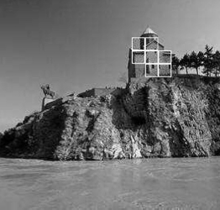
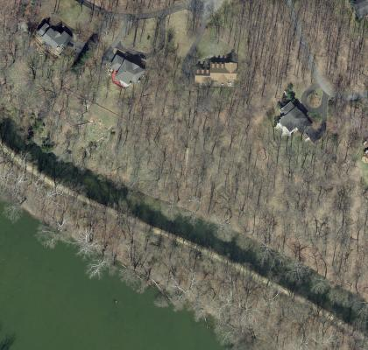
Discriminative Random Fields:
An Implementation for Aerial Structure Detection
Dan Denton Jesse Selover
Milestone Presentation
[6]
[8]

Slide 2
Recap of Stated Milestone Goals
Write a program to facilitate hand-labeling the data images
Download and hand-label the data
Extract features for each image
Code the DRF model
Train the DRF model
Produce preliminary results

Slide 3
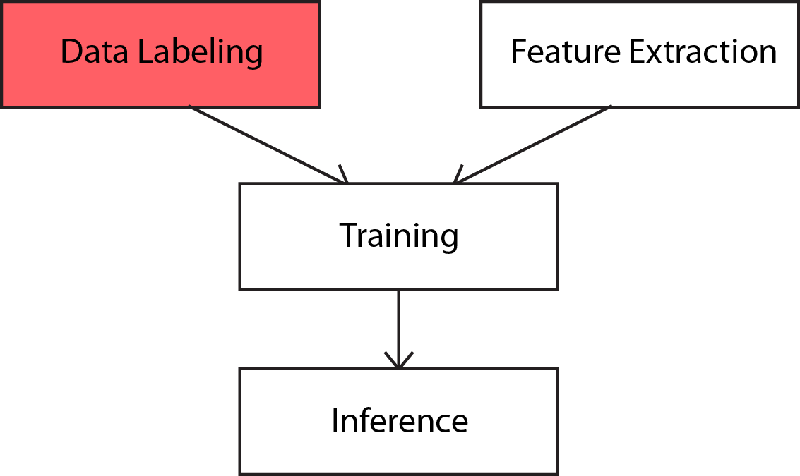
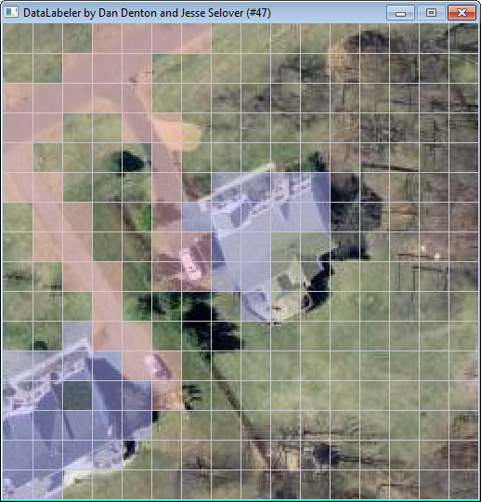
Wrote an application for labeling our images.
Labeled 80 of our images to use with the algorithm.

Slide 4
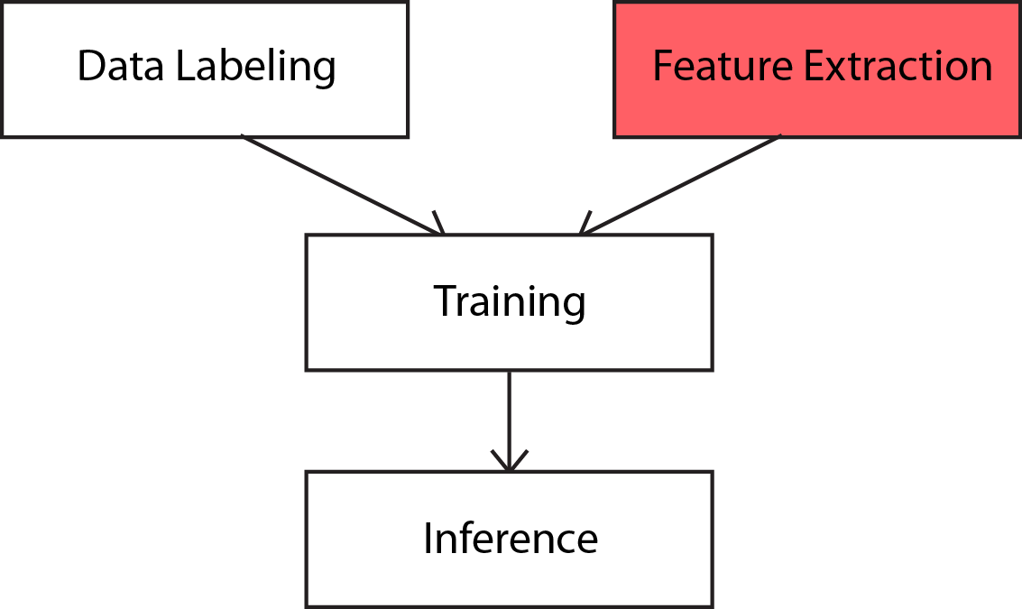
Wrote the loading of images, and convolution with the gradient of a Gaussian, to compute per pixel gradient vectors.
Wrote the calculation of a vector of basis functions using this feature data.

Slide 5
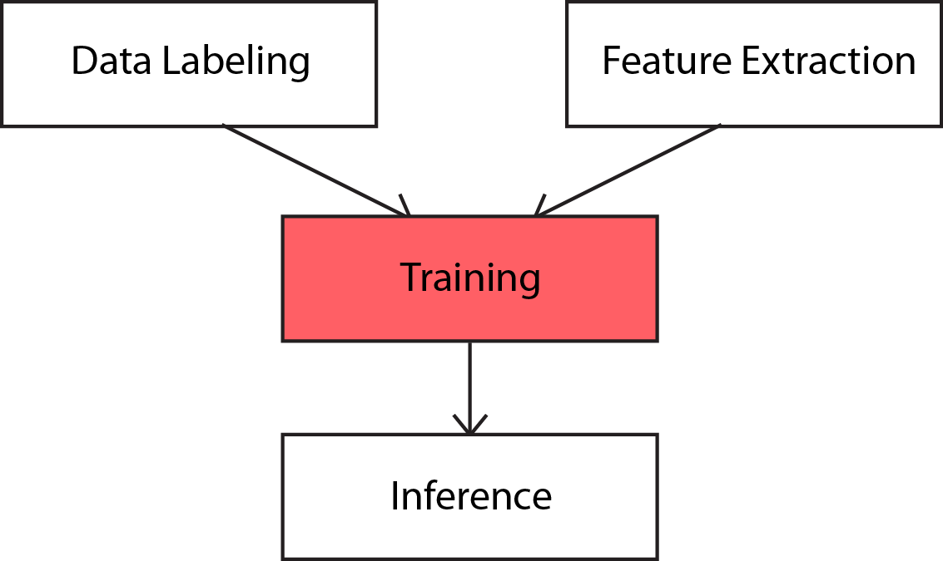
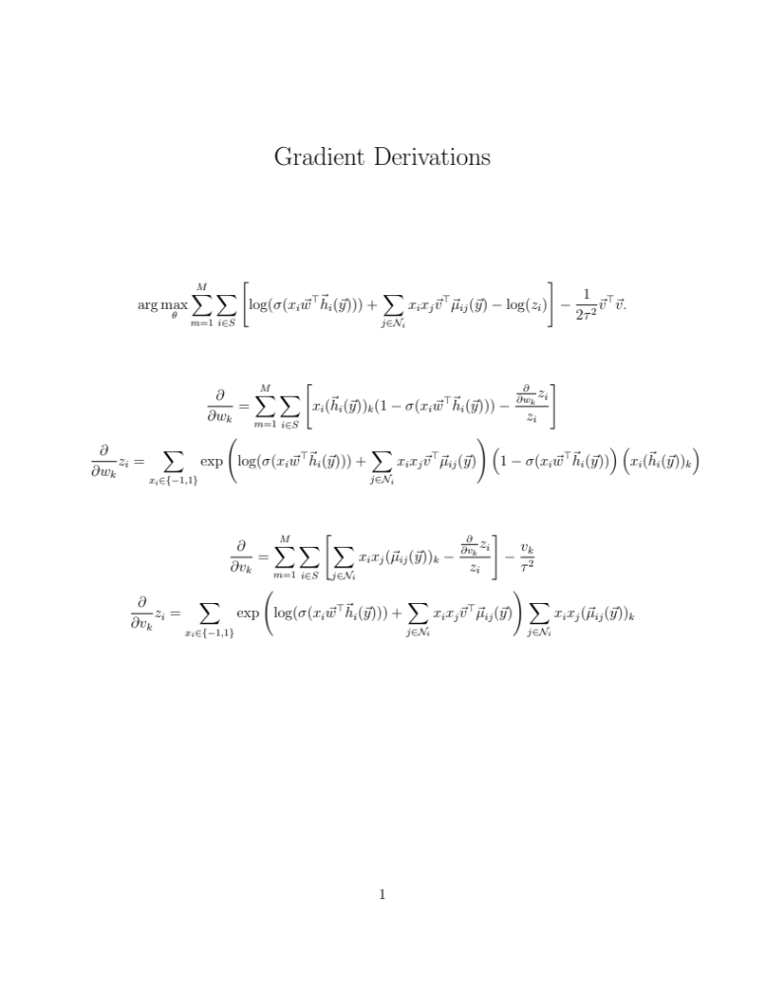
Wrote the training algorithm using iterative gradient ascent with line search.

Slide 6
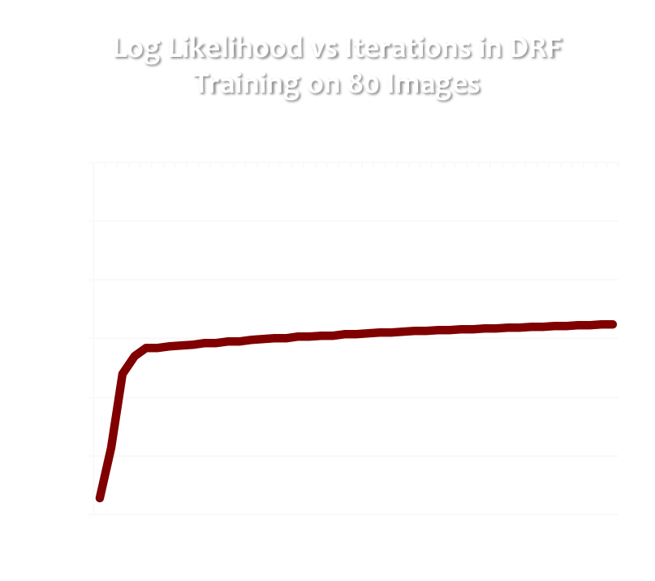
The individual iterations of the training are slow, but the training seems to converge nicely.

Slide 7
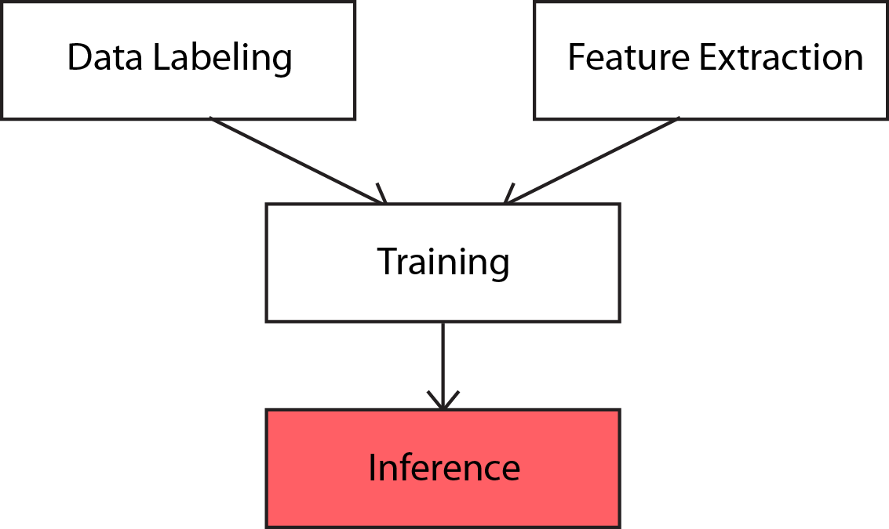
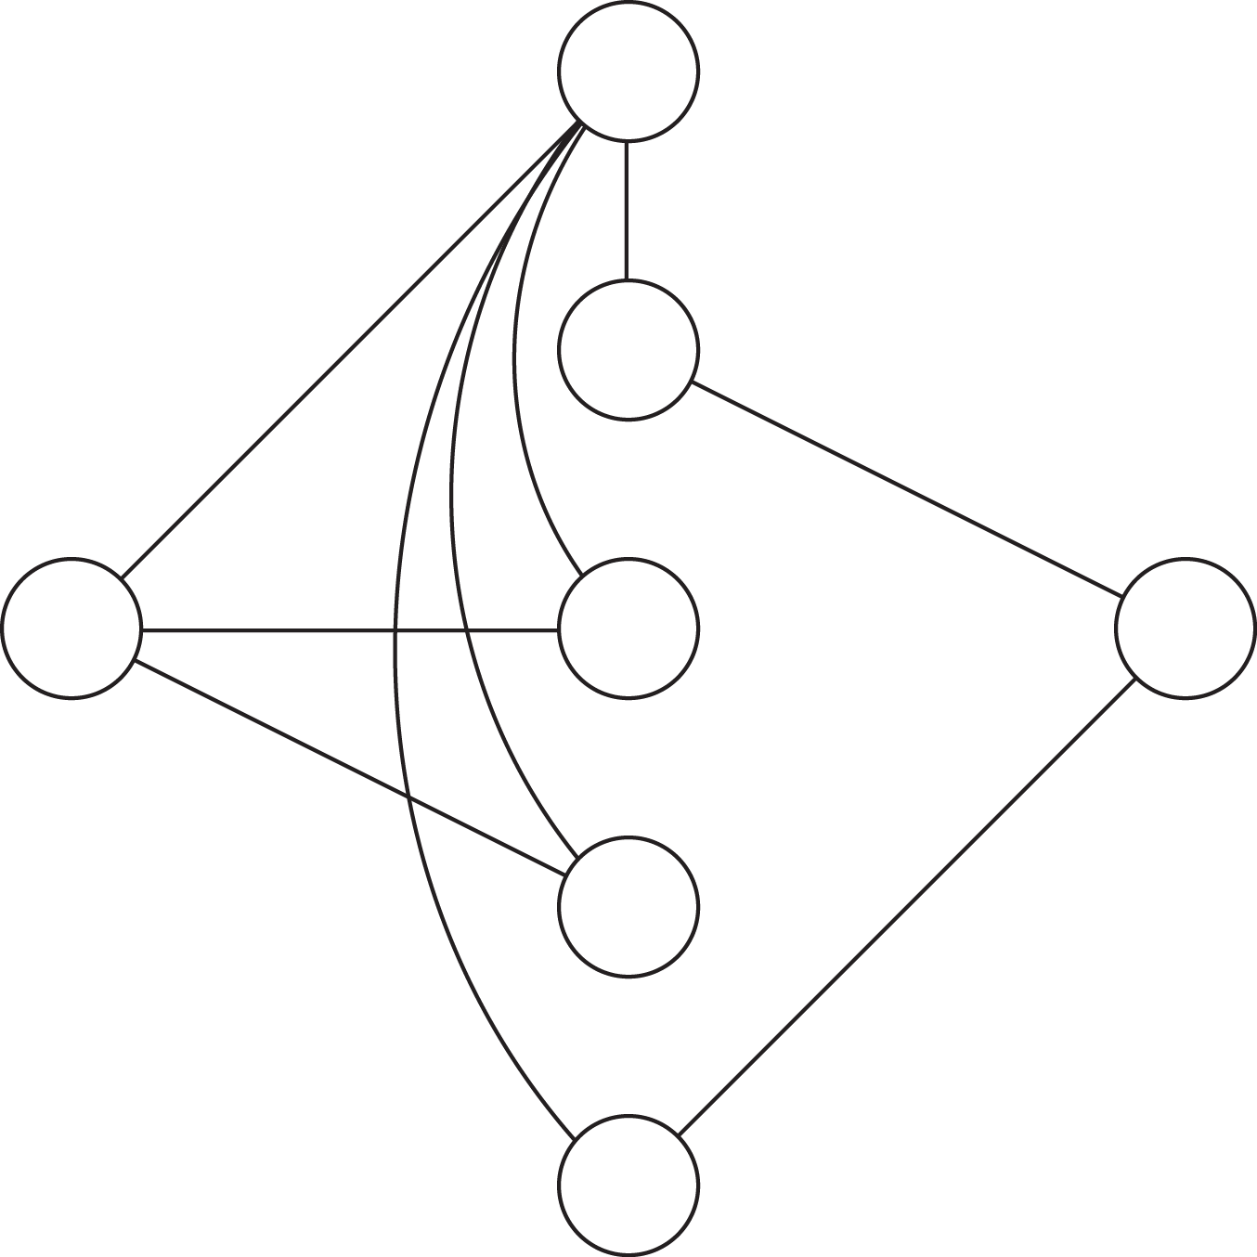
Wrote MAP inference algorithm using Ford–Fulkerson as described by [4].

Slide 8
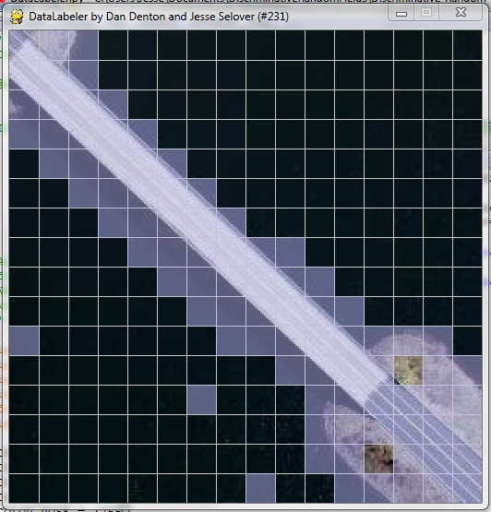
The inference without interaction potential is effectively a logistic classifier (and works like one).

Slide 9
Remaining Work
Find out why classification with interaction potential is not working
Label remaining images and train on the entire training set.
Select the hyper-parameter tau using cross-validation.
Test algorithm on full test data.
Test algorithm with dataset provided by Kumar and Hebert [6].
Aquire and label data used by [1] and [9], and compare test results.

Slide 10
References
[1] C. J. Bellman and M. R. Shortis. A machine learning approach to building recognition in aerial photographs. In International Archives of the Photogrammetry, Remote Sensing and Spatial Information Sciences, pages 50–54, 2002.
[2] R. Cipolla, S. Battiato, and G.M. Farinella. Computer Vision: Detection, Recognition and Reconstruction. Studies in Computational Intelligence. Springer, 2010.
[3] C. Fox and G. Nicholls. Exact map states and expectations from perfect sampling: Greig, porteous and seheult revisited. In Proceedings MaxEnt 2000 Twentieth International Workshop on Bayesian Inference and Maximum Entropy Methods in Science and Engineering CNRS, May 2000.
[4] D. Greig, B. Porteous, and A. Seheult. Exact maximum a posteriori estimation for binary images. Journal of the Royal Statistical Society, 51:271–279, 1989.
[5] S. Kumar and M. Hebert. Discriminative random fields: a discriminative framework for contextual interaction in classification. In Proceedings. Ninth IEEE International Conference on Computer Vision, pages 1150 –1157 vol.2, Oct. 2003.
[6] S. Kumar and M. Hebert. Discriminative random fields. International Journal of Computer Vision, 68(2):179–202, 2006.
[7] J. Lafferty, A. McCallum, and F. Pereira. Conditional random fields: Probabilistic models for segmenting and labeling sequence data. In ICML, pages 282–289. Morgan Kaufmann, 2001.
[8] Maryland GIS Montgomery County, April 2012.
[9] F. Shi, Y. Xi, X. Li, and Y. Duan. Rooftop detection and 3d building modeling from aerial images. In Advances in Visual Computing, volume 5876 of Lecture Notes in Computer Science, pages 817–826. Springer Berlin / Heidelberg, 2009.
[10] R. Szeliski. Computer Vision: Algorithms and Applications. Texts in Computer Science. Springer, 2010.

